Slide 1
Basha High AMS 7th -8th grade Registration form
2025-2026

Slide 2
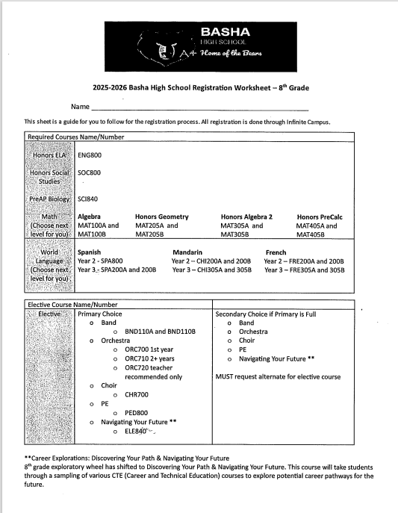

Slide 3
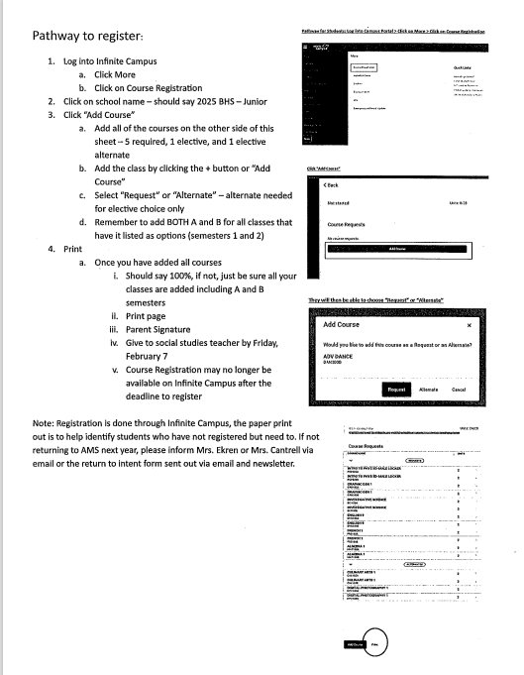

Slide 4
REMINDERS
Once you have added all of your courses in Infinite Campus, PRINT this page and have your parent sign.
Return this to your Social Studies teacher by Friday, February 7.

